Slide 1
GQS Automation Framework Overview
Global Quality Solution (GQS) Automation Team
Information Classification – Company Internal

Slide 2
Table of Contents
Key Design Considerations
Framework Architecture
Consistent Metrics in HP QC
ARD / Automation End to End Workflow
Download & Technical Support

Slide 3
Key Design Considerations
Native Tools
Use “best fit” tool for automation
UFT / Ranorex / Selenium codes
Excel input data
HTML output report
Open Standards
Facilitate interoperability & extensibility
Exchange data b/w different products
Reuse features from coding languages
Light Weight
Less development & support effort
Develop in native tools and languages
Debug and trace in IDE of native tools

Slide 4





Framework Architecture
Applications
Domain App
Desktop
Mainframe
Flash / Flex
Web App
Excel Input
Framework Code
Framework
Domain Code
Automation Scripts
GUI Object Repository
Results
Selenium
UFT
Ranorex
Config
Setup
Modules
File/Data Readers
Driver Script
HTML Report
Test Set/Case
Integration Points
HP ALM/QC
Metrics
Defect
QC Metrics
Adapter
QC Defect Adapter
Reporting
Module
Data
Inputs
… more
Generic Library
Excel I/O
Snapshot
Logging
… more

Slide 5
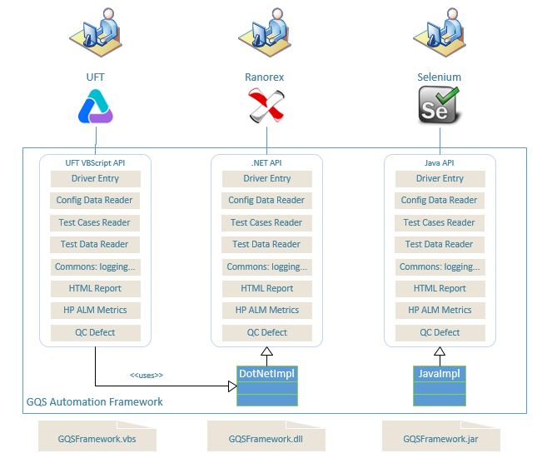

Slide 6





Consistent Metrics in HP QC
QA Team
Implementation is transparent from test management’s point of view in HP QC
QC User Interface
Analytics
Test Run
Test Run ID
Test Case ID
Passed / Failed
... more
Implement
HP ALM API
Automation Tools & New Framework
OTA
API
REST
Service
multiple steps
Metrics
Selenium
UFT
Ranorex
Test Step
Description
Passed / Failed
Expected
Actual
Test Set
Test Set ID
Test Case ID
Test Set Name
1:1 mapping
Automation Suite
Automation Script 1
Automation Script 2
Test Case
Test Case ID
Test Case Name
Auto Yes / No
Automation Script 3
…
Automation Script N
1:1 mapping

Slide 7

ARD / Automation End to End Workflow
Start model based test case design from ARD
Agile Requirement Designer (ARD)
Model
ARIS
TDM Program
Easy for human to read / edit
Easy for automation to parse
Automation
Framework
Support existing UFT / Ranorex
Support open source Selenium
Standard inputs / keywords
Automation
HP Quality
Center (QC)
Upload test result metrics
Attach runtime screenshots
Log test defects
TaskTop Sync to RTC

Slide 8
Summary
Lightweight
Support Multiple Languages: VBS, VB.NET, Java
Same API
Reusable library
Provide default template
Executable Sample Project
Portable & Extensible
Integrate with HP ALM (QC)
Integrate with TDM/ARD

Slide 9
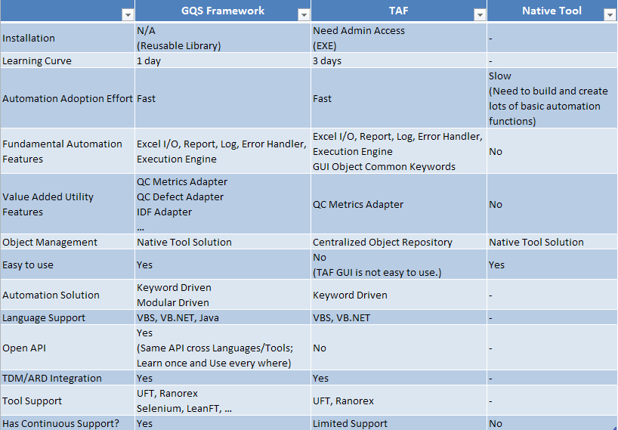
GQS Automation Framework

Slide 10
GQSFramework Development Modal
Develop Application Keyword
Create Test Script / Case Excel File
Prepare Test Data
Define Test Case Mapping
(TestCaseMapping.xlsx)
Create Test Set/Suite
(TestExecution.xlsx)
Setup Configuration Settings
Run
Check Test Results

Slide 11
GQS Automation Framework Timeline
12/26
Start Coding
3/31
Automation Adapter: 1.0 Release
6/30
Framework Version 1.1
HP ALM (QC) Adapter
2017 Q1
10/9
Framework Version 1.2
Ranorex Adapter
GQS Automation
Framework V1.1
VBS Adapter
2017 Q2
Java Adapter
GQS Automation
Framework V1.2
Support VBS. VB.NET, Java languages;
Data Driven & Keyword Driven Automation Framework
Runnable Sample Projects;
Upload QC Defect
…
2017 Q3
GQS Automation
Framework V1.3
Support TDM/ARD;
ALM/QC on-demand new features;
IDF Adapter;
Framework Adoption: EMEA, APAC, GM domains
…
2017 Q4
Framework Adoption
On-demand support
New Features/Enhancements:
Support data comparison: Integrate with ETLTestingTool;
Provide CMD line/offline mode for QC related utility functions;
…
Phase 1
Phase 2
Phase 3
Future Plan

Slide 12
Download
Download location
https://collaborate.statestr.com/sites/GQS/SitePages/SQE.aspx?RootFolder=%2Fsites%2FGQS%2FSQE%20Team%20Documents%2FGQS%20Framework%20Artifacts&FolderCTID=0x012000F9960FF8839EAA43AC733B39D4AAC392&View={065B4EA9-CBC0-4005-8E2F-D82CA39775E8}

Slide 13

Technical Support
Please contact AutomationCoreTeam@StateStreet.com
Framework Backlog Tracking
https://collaborate.statestr.com/sites/GQS/Lists/Framework_backlog/AllItems.aspx
Framework Issues Tracking
https://collaborate.statestr.com/sites/GQS/Lists/Framework_issue/AllItems.aspx

